Slide 1
Anticipatory Wireless Bitrate Control for Blocks
Xiaozheng Tie, Anand Seetharam,
Arun Venkataramani, Deepak Ganesan, Dennis Goeckel
University of Massachusetts Amherst
Notes:
Good afternoon. I am Xiaozheng Tie from University of Massachusetts Amherst. In this talk, I will present a new approach to wireless bitrate control called anticipatory bitrate control.
This is joint work with Anand Seetharam, Arun Venkataramani, Deepak Ganesan and Dennis Goeckel, all from UMASS.

Slide 2
Wireless bitrate control
Goal: To optimize goodput by adapting effective sending rate to channel quality
Bad
channel
6Mbps
Data packet
1Mbps
Channel feedback
Good
channel
2Mbps
Good
channel
• • •
Notes:
I will begin by introducing the wireless bitrate control problem. Wireless bitrate control seeks to adapt the effective transmission rate to the channel quality in order to optimize the goodput at the receiver.
A standard way of approaching this problem today is as follows. Consider a simple example of data transmission between a sender and a receiver. Suppose the sender sends a data packet at an initial bitrate of say 6Mbps. Upon receiving this packet, the receiver sends back an acknowledgment conveying feedback about the channel quality to the sender. If this feedback indicates that the channel quality has worsened, the sender sends the next packet at a lower bitrate, say 1Mbps, which translates to a proportionally longer time to transmit the packet. On the other hand, if the feedback indicates that the channel quality has improved, the sender sends the next packet at a higher bitrate, for example 2Mbps. Note that this channel feedback may be explicit, for example the signal-to-noise ratio measured at the receiver, or implicit, for example, the sender may infer via a timeout that the channel quality has worsened if it receives no feedback because either the packet or the acknowledgment got lost.
The bottom line is that state-of-the-art bitrate control schemes rely heavily on feedback at a per-packet granularity. However, per-packet feedback incurs a high overhead.

Slide 3
Blocks reduce overhead
Blocks = Large batch of packets
  E.g., 64KB MAC block in 802.11n
  1MB block in Hop transport [NSDI’09]
DIFS
DIFS
Backoff
Backoff
X
Packet
SIFS
X
X
Timeout
X
Ack
SIFS
Backoff
DIFS
Backoff
• • •
Packet transmission
Block transmission
Notes:
Independent of the bitrate control problem, per-packet control overhead has been recognized as a critical problem in wireless networks. To address this problem, recent research efforts as well as technology trends have emphasized “blocks”. A block is simply a large batch of packets that helps amortize control overhead. For example, commodity 802.11n cards support blocks of up to 64KB; and Hop, a recently proposed transport protocol uses a block size of up to 1MB.
To appreciate why control overhead significantly impacts goodput , let’s compare data transmission using packets and blocks. Transmitting a packet incurs a carrier sensing interval, DIFS, and a possible backoff. A successful packet transmission results in a brief holding period, SIFS, and transmission of an acknowledgment. Under good channel conditions, this combined overhead is acceptable. However, under poor channel conditions which causes packet or acknowledgement losses, multiple rounds of timeouts and backoffs can severely increase the time overhead for a single packet.
In contrast, a block batches multiple packets and sends them together as a single unit before any acknowledgment. Lost packets are retransmitted in subsequent blocks. Therefore, blocks can significantly reduce per-packet overhead and improve goodput.

Slide 4
Responsiveness vs. overhead
6Mbps
6Mbps
6Mbps
6Mbps
6Mbps
X
1Mbps
6Mbps
X
6Mbps
X
6Mbps
2Mbps
Can we have both high responsiveness and low overhead?
Packet bitrate control
High responsiveness
High overhead
Block transmission
Low responsiveness
Low overhead
Notes:
Unfortunately, these two trends – packet-based bitrate control – and block-based transmission – have a fundamental disconnect. Packet-based bitrate control, as shown on the left, is highly responsive as it can react to channel changes on a per-packet basis, but is inefficient because of the high overhead associated with packets. On the other hand, block-based transmission, as shown on the right, is efficient as it amortizes overhead, but is not sufficiently responsive to channel changes as it only gets infrequent feedback. In this example on the right, 6Mbps is appropriate for the first three packets in the block, but is too aggressive for subsequent packets that get lost.
This disparity raises a central research question: Can we have both high responsiveness of bitrate control and low overhead of blocks?

Slide 5
Outline
Why anticipatory bitrate control
BlockRate design and implementation
Evaluation
Conclusion
Notes:
The answer to that question is anticipatory bitrate control. In the rest of this talk, I will first experimentally motivate anticipatory bitrate control, then present BlockRate’s anticipatory design, followed by evaluations and conclusions.
To appreciate the need for anticipatory bitrate control, we need to understand better the tradeoff between overhead and responsiveness. We start by asking “What matters more, overhead or responsiveness?” in static as well as mobile settings.

Slide 6
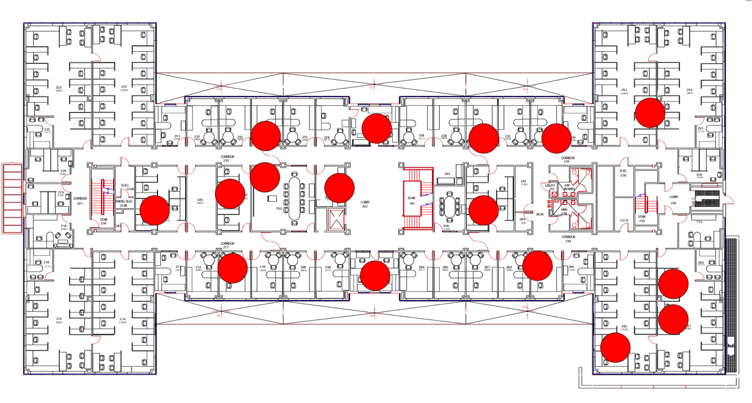
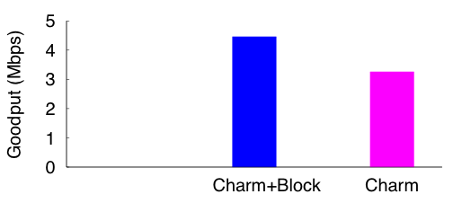
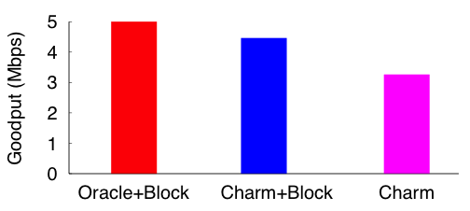
Overhead vs. responsiveness (1)
Overhead matters more in static settings
1.6x
[Mobisys’08]
(Block-based)
(Block-based)
(Packet-based)
Notes:
Our experimental results in static settings show that overhead is more important than responsiveness. We compare Charm, a state-of-the-art packet-based bitrate control protocol with Charm+Block, a naïve, straightforward implementation of Charm as-is with blocks. The barchart shows on the Y axis the mean goodput across 30 links on an indoor mesh testbed for different protocols on the X axis. Charm+Block improves goodput by 1.6x over Charm, which indicates that the overhead amortization benefits of blocks significantly outweigh the performance loss due to reduced responsiveness to channel changes.
A natural question is how much room there is for further improvement over Charm+Block. To answer this question, we measured the performance of Oracle+Block, a protocol that knows the best bitrate for each packet in a block through a tedious a priori measurement process. In this static setting, we find that Oracle+Block is only slightly better than Charm+Block.
This result may appear to suggest that simply using packet-based bitrate control schemes as-is with blocks is sufficient to get most of the achievable gains, i.e., responsiveness is unimportant.

Slide 7


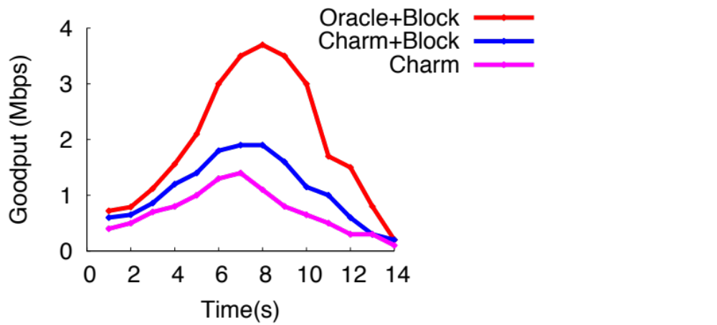
Overhead vs. responsiveness (2)
Both overhead and responsiveness matter in mobile settings
Data
30mph
2x
• • •
• • •
6Mbps
6Mbps
6Mbps
6Mbps
1.7x
6Mbps
12Mbps
12Mbps
6Mbps
12Mbps
• • •
• • •
Charm+Block
Oracle+Block
Notes:
However, the situation is very different in mobile settings with frequent and significant variations in channel quality. To study the impact of mobility, we conduct an experiment on a vehicular testbed, which consists of an AP placed in a downtown area and a client placed in a car approaching the AP and then away from it, moving at a speed of roughly 30mph.
The bottom graph shows the goodput measured every second on the Y axis as a function of time on the X axis. All protocols show a period of increasing goodput followed by decreasing goodput, which is consistent with the movement direction of the car. As in the previous static setting, Charm+Block outperforms the packet-based protocol Charm. However, unlike the static setting, Oracle+Block significantly outperforms Charm+Block and the peak goodput difference can be as high as 2x!
To understand why Oracle+Block outperforms Charm+Block, let’s take a deeper look at their bitrate selection decisions. The right graph zooms into the bitrates over the course of one block transmission. Charm+Block assumes all packets in a block experience the same channel and thus are sent at the same bitrate, therefore it fails to respond to intra-block variation. In contrast, Oracle+Block selects different bitrates within a block as it has prior knowledge about future channel conditions.
Although Oracle+Block is not achievable in practice, we ask the question "how can we come close to it"?

Slide 8
Outline
Why anticipatory bitrate control
BlockRate design and implementation
Evaluation
Conclusion
Notes:
The answer is BlockRate, a bitrate control protocol optimized for blocks.

Slide 9
Anticipatory bitrate control
Anticipatory = Selecting multiple bitrates predictive of future channel conditions.
6Mbps
6Mbps
6Mbps
6Mbps
12Mbps
Good
channel
6Mbps
12Mbps
6Mbps
12Mbps
12Mbps
Bitrate control for packets
Anticipatory bitrate control for blocks
Notes:
The key insight in BlockRate is anticipatory bitrate control, i.e., select multiple bitrates that are predictive of future channel conditions. To appreciate, here is why anticipatory bitrate control can reduce overhead without compromising responsiveness compared to traditional packet-based bitrate control.
Packet-based bitrate control schemes, as shown on the left, implicitly assume that channel conditions do not change significantly over one packet or two, thus the channel predicted for the next packet is the same as that experienced by the most recent packet. For example, if the feedback for a packet sent at 6Mbps indicates that the channel has improved, the sender will assume the channel is going to remain good in the near future and might send the next packet at a higher bitrate of 12Mbps.
In contrast, block transmissions by design get only infrequent channel feedback. As shown in the example on the right, without any additional feedback, the sender must be able to predict that the channel will get better or worse over the course of a block transmission and increase or decrease bitrates accordingly for corresponding packets. How would it do it?

Slide 10

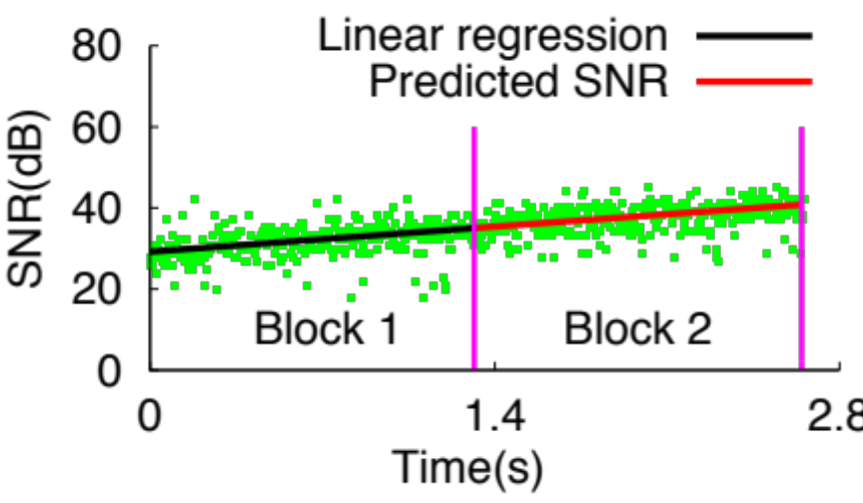
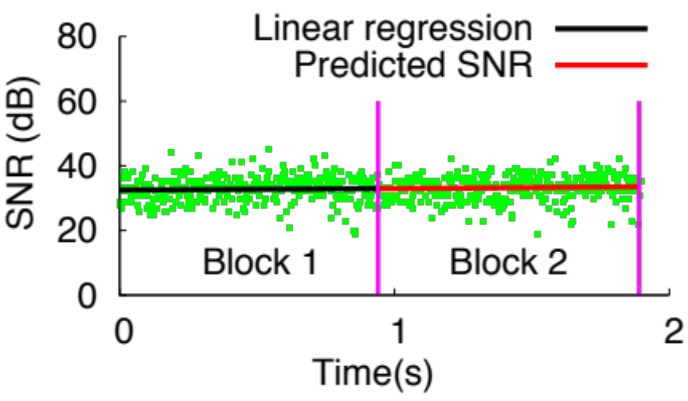
Predict SNR trend: Slow-changing
Linear regression model
  Assumes SNR linearly varies with time in slow-changing scenarios
Pedestrian (1m/s)
Static
Notes:
BlockRate predicts future channel changes in terms of packet SNRs using two simple prediction models. The first is a linear regression model invoked in slow-changing environments such as in static or pedestrian mobility scenarios.
To illustrate, consider the graph showing the packet SNRs from one block to the other where one laptop moved towards the other at walking speed. The Y axis is the packet SNRs in dB and the X axis is the time in seconds. Packet SNRs have a weak upward trend even though the instantaneous values show some variation. Based on these SNR values, the linear regression model estimates the regression line for one block as the one indicated by the black line, and extends the line to predict the SNR trend of the next block as shown in the red line. In the pedestrian mobility scenario, the linear regression model effectively predicts the SNR trend well.
The model also extends to static scenarios where the average SNR remains nearly constant as shown in the graph.

Slide 11
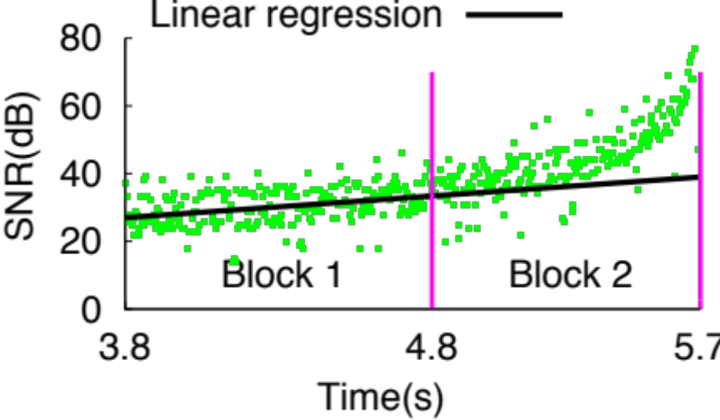
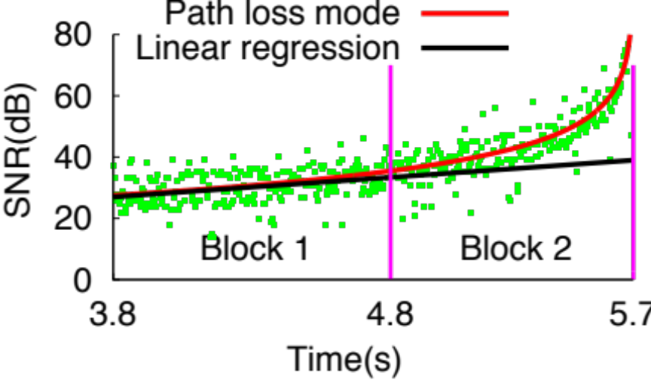
Predict SNR trend: Fast-changing
Path loss model
  Assumes SNR logarithmically varies with distance in fast-changing scenarios
SNR(d)= SNR(d₀) – 10αlog(d/d₀)
30mph
Notes:
Although the linear regression line works well in the previous slow-changing environments, it works poorly in fast-changing environments where SNR changes rapidly. For example, the bottom graph shows the packet SNRs across two blocks observed by a receiver kept in a car approaching an AP at 30mph. The linear regression method deviates considerably from the actual SNRs.
To address this problem, BlockRate adopts the wireless channel path loss model to model this non-linear variation of SNRs over time. The model assumes that SNR has a logarithmic relationship with distance, specifically, the SNR at a certain distance d, is a function of the SNR at a reference distance d0, a path loss exponent alpha and the log of d over d0. The bottom graph shows that the path loss model indeed fits the SNR variations under vehicular mobility well.
There is a caveat associated with this model. The model needs to know the current distance d in order to predict the SNR in the near future. To this end, BlockRate’s current implementation relies on GPS devices that are commonly available on mobile devices today.

Slide 12
BlockRate design summary
Slow mobility?
30dB
No
6Mbps
Yes
SNR | Bitrate
… | …
40dB | 12Mbps
… | …
Linear regression
6Mbps
40dB
Path loss
12Mbps
12Mbps
• • •
1. Predict future SNR based on mobility pattern
2. Lookup SNR-Bitrate table to select anticipatory bitrate
Notes:
Based on these prediction models, BlockRate selects bitrates in an anticipatory manner as follows. First, the prediction module determines if the environment is slow or fast changing and accordingly picks the appropriate channel model to predict the SNR over the course of the next block. Second, BlockRate uses an SNR-bitrate table to determine the bitrate that maximizes the goodput for that SNR. For example, as shown here, if the predicted SNR increases from 30dB to 40dB, the sender will increase the bitrate from 6 to 12Mbps for the corresponding packets.

Slide 13
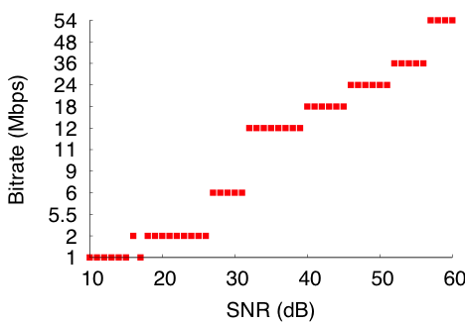
SNR-Bitrate table
Maintains bitrate that maximizes goodput at each SNR
Notes:
Here is an example of the SNR-bitrate mapping. For each value of SNR on the X-axis, the graph shows the bitrate that maximizes the goodput at that SNR on the Y-axis. BlockRate maintains this table based on the observed goodput at different values of SNR in the recent past. In this respect, BlockRate is similar to other SNR-based bitrate control schemes. It’s novelty lies using this SNR-based bitrate control scheme in an anticipatory manner.

Slide 14
Outline
Why anticipatory bitrate control
BlockRate design and implementation
Evaluation
Conclusion
Notes:
Next, I will present the evaluation results.

Slide 15
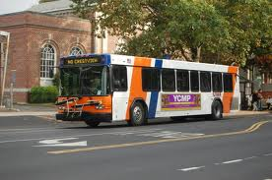


Experimental setup
Vehicular
Pedestrian
Static
V-to-V: 20 buses
2 mobile laptops
Mesh:16 MacMini nodes
Pedestrian
V-to-AP: 2 cars
ns3 simulation
Notes:
We implemented a prototype of BlockRate in the MadWiFi driver. We evaluated BlockRate via deployment on several testbeds as well as via simulations. Our evaluation incorporates a variety of mobility scenarios including vehicular, pedestrian and static scenarios. Due to time constraint, I will focus on results on the two vehicular testbeds and trace-driven simulation. The first testbed V-to-V consists of 20 public transit buses. These buses exchange data when they cross each other. The second testbed V-to-Ap is composed of 2 cars each equipped with a laptop. The ns3 simulation is based on real pedestrian traces and it allows us to compare BlockRate with the most recent PHY-layer aware protocol that 802.11 deployment is not available.

Slide 16
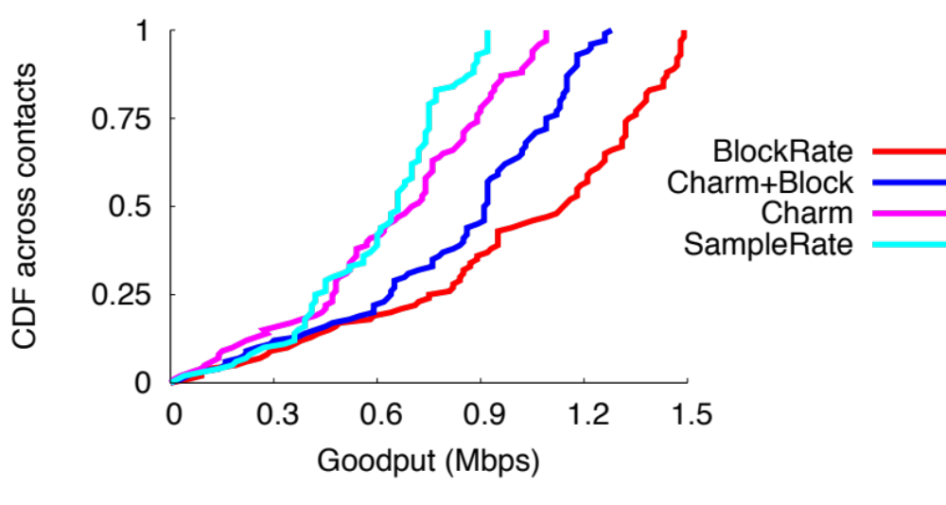
Performance in V2V testbed
 | BlockRate | Charm+Block | Charm | SampleRate
#V2V contacts | 1745 | 1822 | 1524 | 1719
1.3x
Notes:
We first evaluate BlockRate on the vehicle-to-vehicle testbed. As it is not feasible to simultaneously deploy all protocols, we evaluated them on different weekdays. As shown in the table, all protocols have a comparable number of V2V contacts as we are interested only in their aggregate performance statistics.
The graph shows the CDF of goodput across contacts. BlockRate improves median goodput by 1.3x over Charm+Block and significantly outperforms packet-based protocols Charm and SampleRate. The improvement over Charm+Block attests to Blockrate’s ability to predict the future SNR trend and select multiple bitrates within a block. In contrast, Charm+Block performs worse because it uses the same bitrate for all packets in a block and is unable to adapt to intra-block variations.

Slide 17
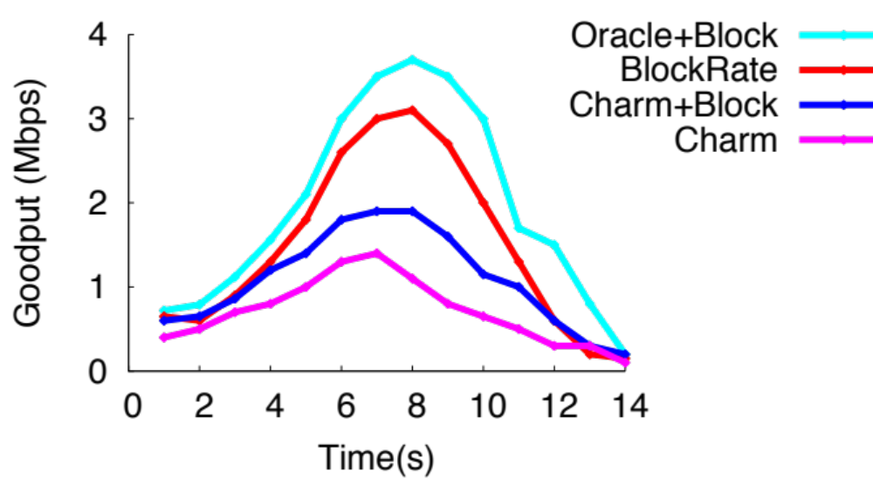
Performance in V-to-AP testbed
Data
30mph
1.6x
Notes:
We next evaluate BlockRate in the Vehicle-to-AP setting. We place a laptop as an AP in a downtown area and another laptop on a car passing the AP. This experiment is similar to the one I showed earlier. The new addition is the red line corresponding to BlockRate.
The graph shows that BlockRate outperforms Charm+Block and the peak goodput different is as high as 1.6x. The figure also shows that there is still room for improvement compared to Oracle+Block. This difference is due to the inaccuracies in estimating SNR using the path loss model and the location information obtained from GPS devices.

Slide 18
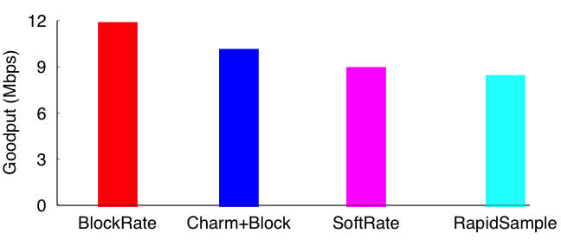
Performance in pedestrian mobility
Pedestrian mobility trace-driven simulation in ns-3
(Uses PHY-hint)
(Uses movement-hint)
Notes:
Finally I will present the evaluation in slow-changing pedestrian mobility scenarios. We compare BlockRate with two recent non-SNR based protocols SoftRate and RapidSample that respectively use PHY-layer hints or sensor-based movement hint to select the bitrate. We use the pedestrian mobility trace and the ns-3 implementation from the SoftRate paper and conduct this simulation. The graph shows the mean goodput across 10 mobile traces on the Y axis for different protocols. BlockRate outperforms packet-based protocols SoftRate and Rapidsample due to its overhead amortization benefits of blocks. It outperforms Charm+Block because of its anticipatory design.

Slide 19
Conclusion
State-of-the-art bitrate control schemes must pick one: low overhead or high responsiveness
BlockRate achieves both benefits
  Anticipatory bitrate control using blocks reduces overhead while being responsive
Thank you!
Notes:
In summary, we have argued that state-of-the-art bitrate control schemes must pick one of the two: low overhead using blocks or high responsiveness of packet-based bitrate control.
Our contribution is the design and implementation of BlockRate, a bitrate control scheme that achieved both benefits. BlockRate uses blocks to amortize overhead, however its key insight is to control bitrates in an anticipatory manner, i.e., without any new feedback, it selects different bitrates within a block that are predictive of future channel quality. Our evaluation under a variety of realistic mobility scenarios confirms not only that it is possible to predict future channel quality trends, but also use these predictions to achieve significant performance gains in bitrate control.

